Slide 1
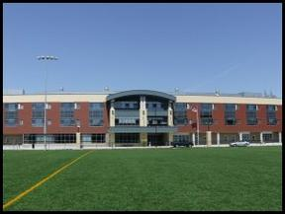
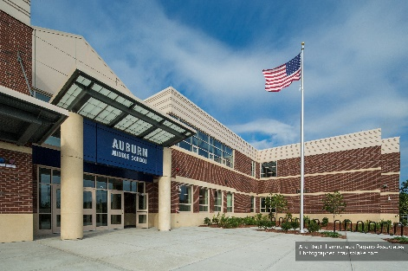
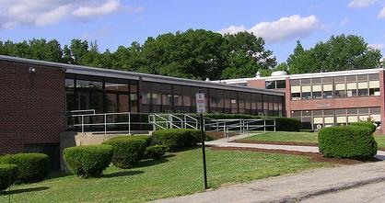
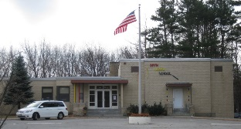
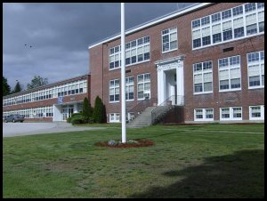
AUBURN HIGH SCHOOL
SCHOOL IMPROVEMENT PLAN 2017-2019
Excellence in Education by Putting Students First
Auburn High School
Auburn Middle School
Swanson Road Intermediate
School
Bryn Mawr School
Pakachoag School

Slide 2
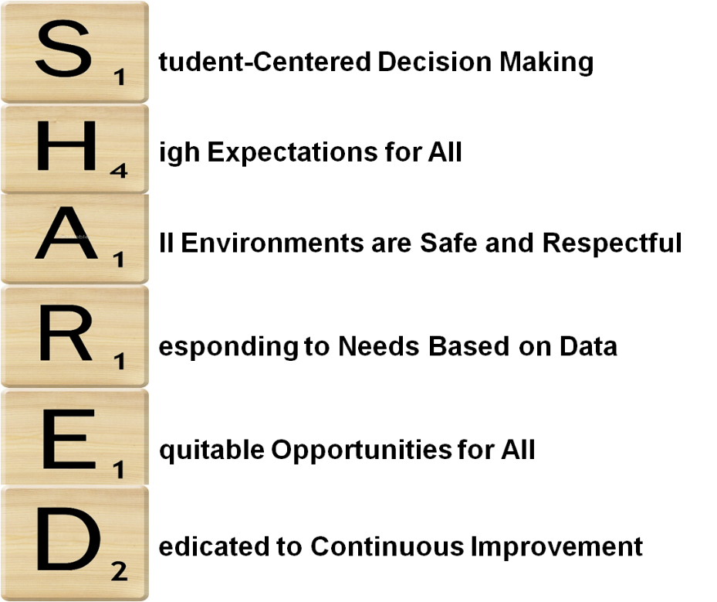
Our vision is to educate and prepare students for the opportunities and challenges of a changing world.
Strengthening Connections through Rigor, Relevance and Relationships.

Slide 3
TEACHING and LEARNING: To Further Advance Rigorous and Relevant Teaching and Learning
NEASC Accreditation
Learning Walks
Advanced Placement Program
Virtual High School On-Line Learning
Early College Opportunities
TECHNOLOGY: To Support Learning, Communications and Operations
iPad initiative continues at high school
STEM opportunities
@AuburnRockets Twitter account
Upgraded Wireless Access Points
Digital Marquis

Slide 4
COMMUNITY PARTNERSHIPS: To Strengthen and Create Collaborative Partnerships
Auburn Youth and Family Services
Auburn Chamber of Commerce
Quinsigamond Community College’s Early College / 12th Yr. Program
Major David Brodeur Memorial Foundation
Scholarship Opportunities and Local Businesses
HEALTH, WELLNESS & SAFETY: To Promote a Positive, Healthy and Safe Learning Environment
Alice Training
Mental Health Awareness
Drug Education
AHS Care Program
Grant Funded Initiatives in PE, Health, Regular Ed.

Slide 5
TRANSITIONS: To Build and Strengthen Supportive Transitions
8th Grade Transition – January, June, August
Freshman Academy – Trips and Workshops
Guidance Groups – Social, Emotional, Academics
Senior Seminar – College, Work, Military

Slide 7
FY 2019 Budget Strengthening Connections through Rigor, Relevance and Relationships
Support Costs | FY 2018 | FY 2019
Postage | $2,500 | $2,500
Principal’s Office Supplies | $1,180 | $1,180
Printing Supplies | $16,000 | $16,000
Principal’s Dues | $5,499 | $5,499
Principals’ Prof. Development | $5,500 | $3,000
Commencement | $15,419 | $15,475
Classroom Supplies | $23,860 | $23,860
504 Supplies | $250 | $250
Art Supplies | $4,675 | $4,275
Staff Travel | $500 | $500

Slide 8
FY 2019 Budget Strengthening Connections through Rigor, Relevance and Relationships
Support Costs | FY 2018 | FY 2019
Textbooks | District – Wide | District – Wide
E-Books | District – Wide | District – Wide
Library Supplies / Books | $10,000 | $10,000
Audio-Visual Supplies | $1,190 | $1,190
Guidance Supplies | $10,054 | $10,054
Wood Technology | $5,940 | $5,940
Graphics | $9,130 | $7,586
Athletic/PE Supplies | $3,725 | $3,747
Music/Fine Arts Supplies | $4,025 | $3,617
Curriculum Competitions | $15,660 | $19,060
Awards | $2,460 | $2,890

Slide 9
Support Costs | FY 2018 | FY 2019
Total | $137,567 | $136,623

